Slide 1

How to Sell AP Automation to Your Organization
+
Insert Your Company Logo Here

Slide 2
AGENDA
Overview of AvidXchange
What are AP and Payment Automation?
Impact of Automating Payables
Return on Investment
45-Day Implementation

Slide 3
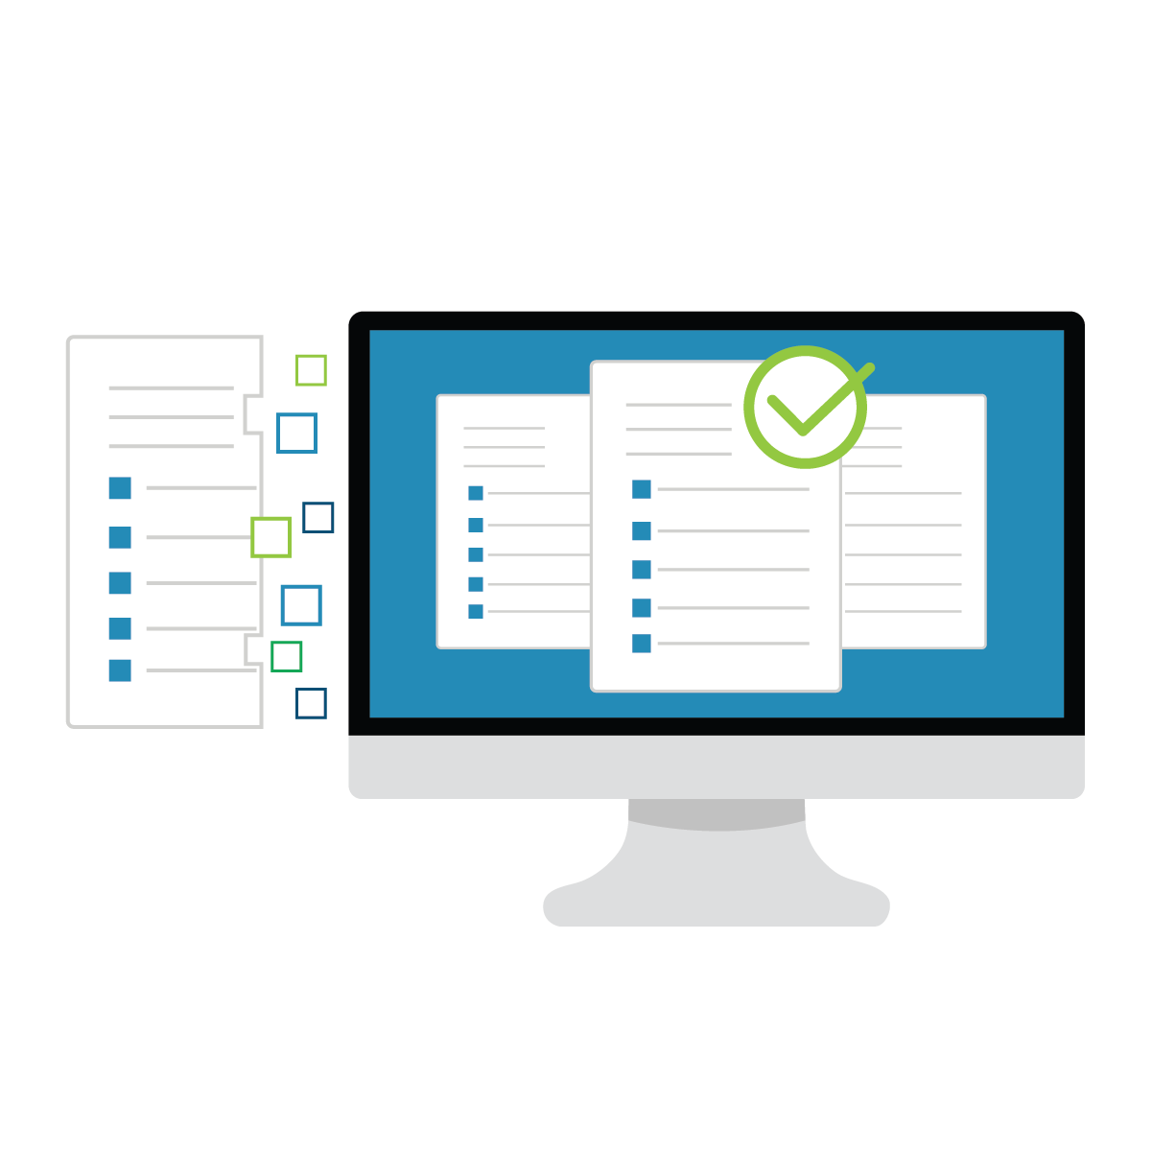
WHO IS AVIDXCHANGE?
AvidXchange revolutionizes the way companies pay their bills.
An industry leader in automating invoice and payment processes for midmarket companies
More than 6,000 clients throughout North America

Slide 4
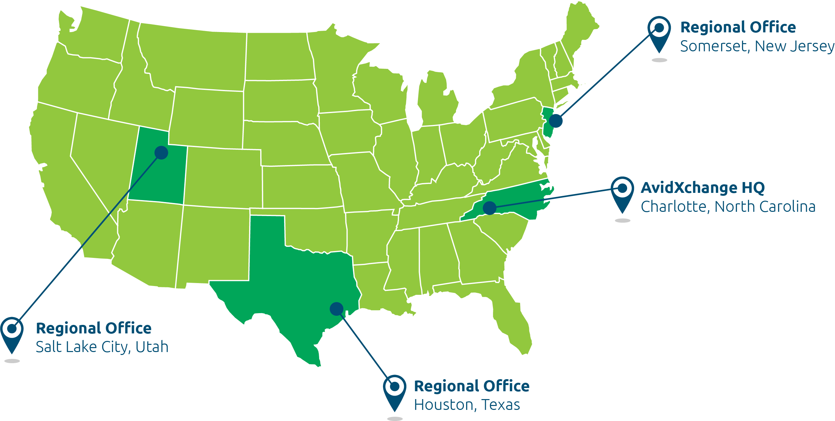
LOCATIONS

Slide 5
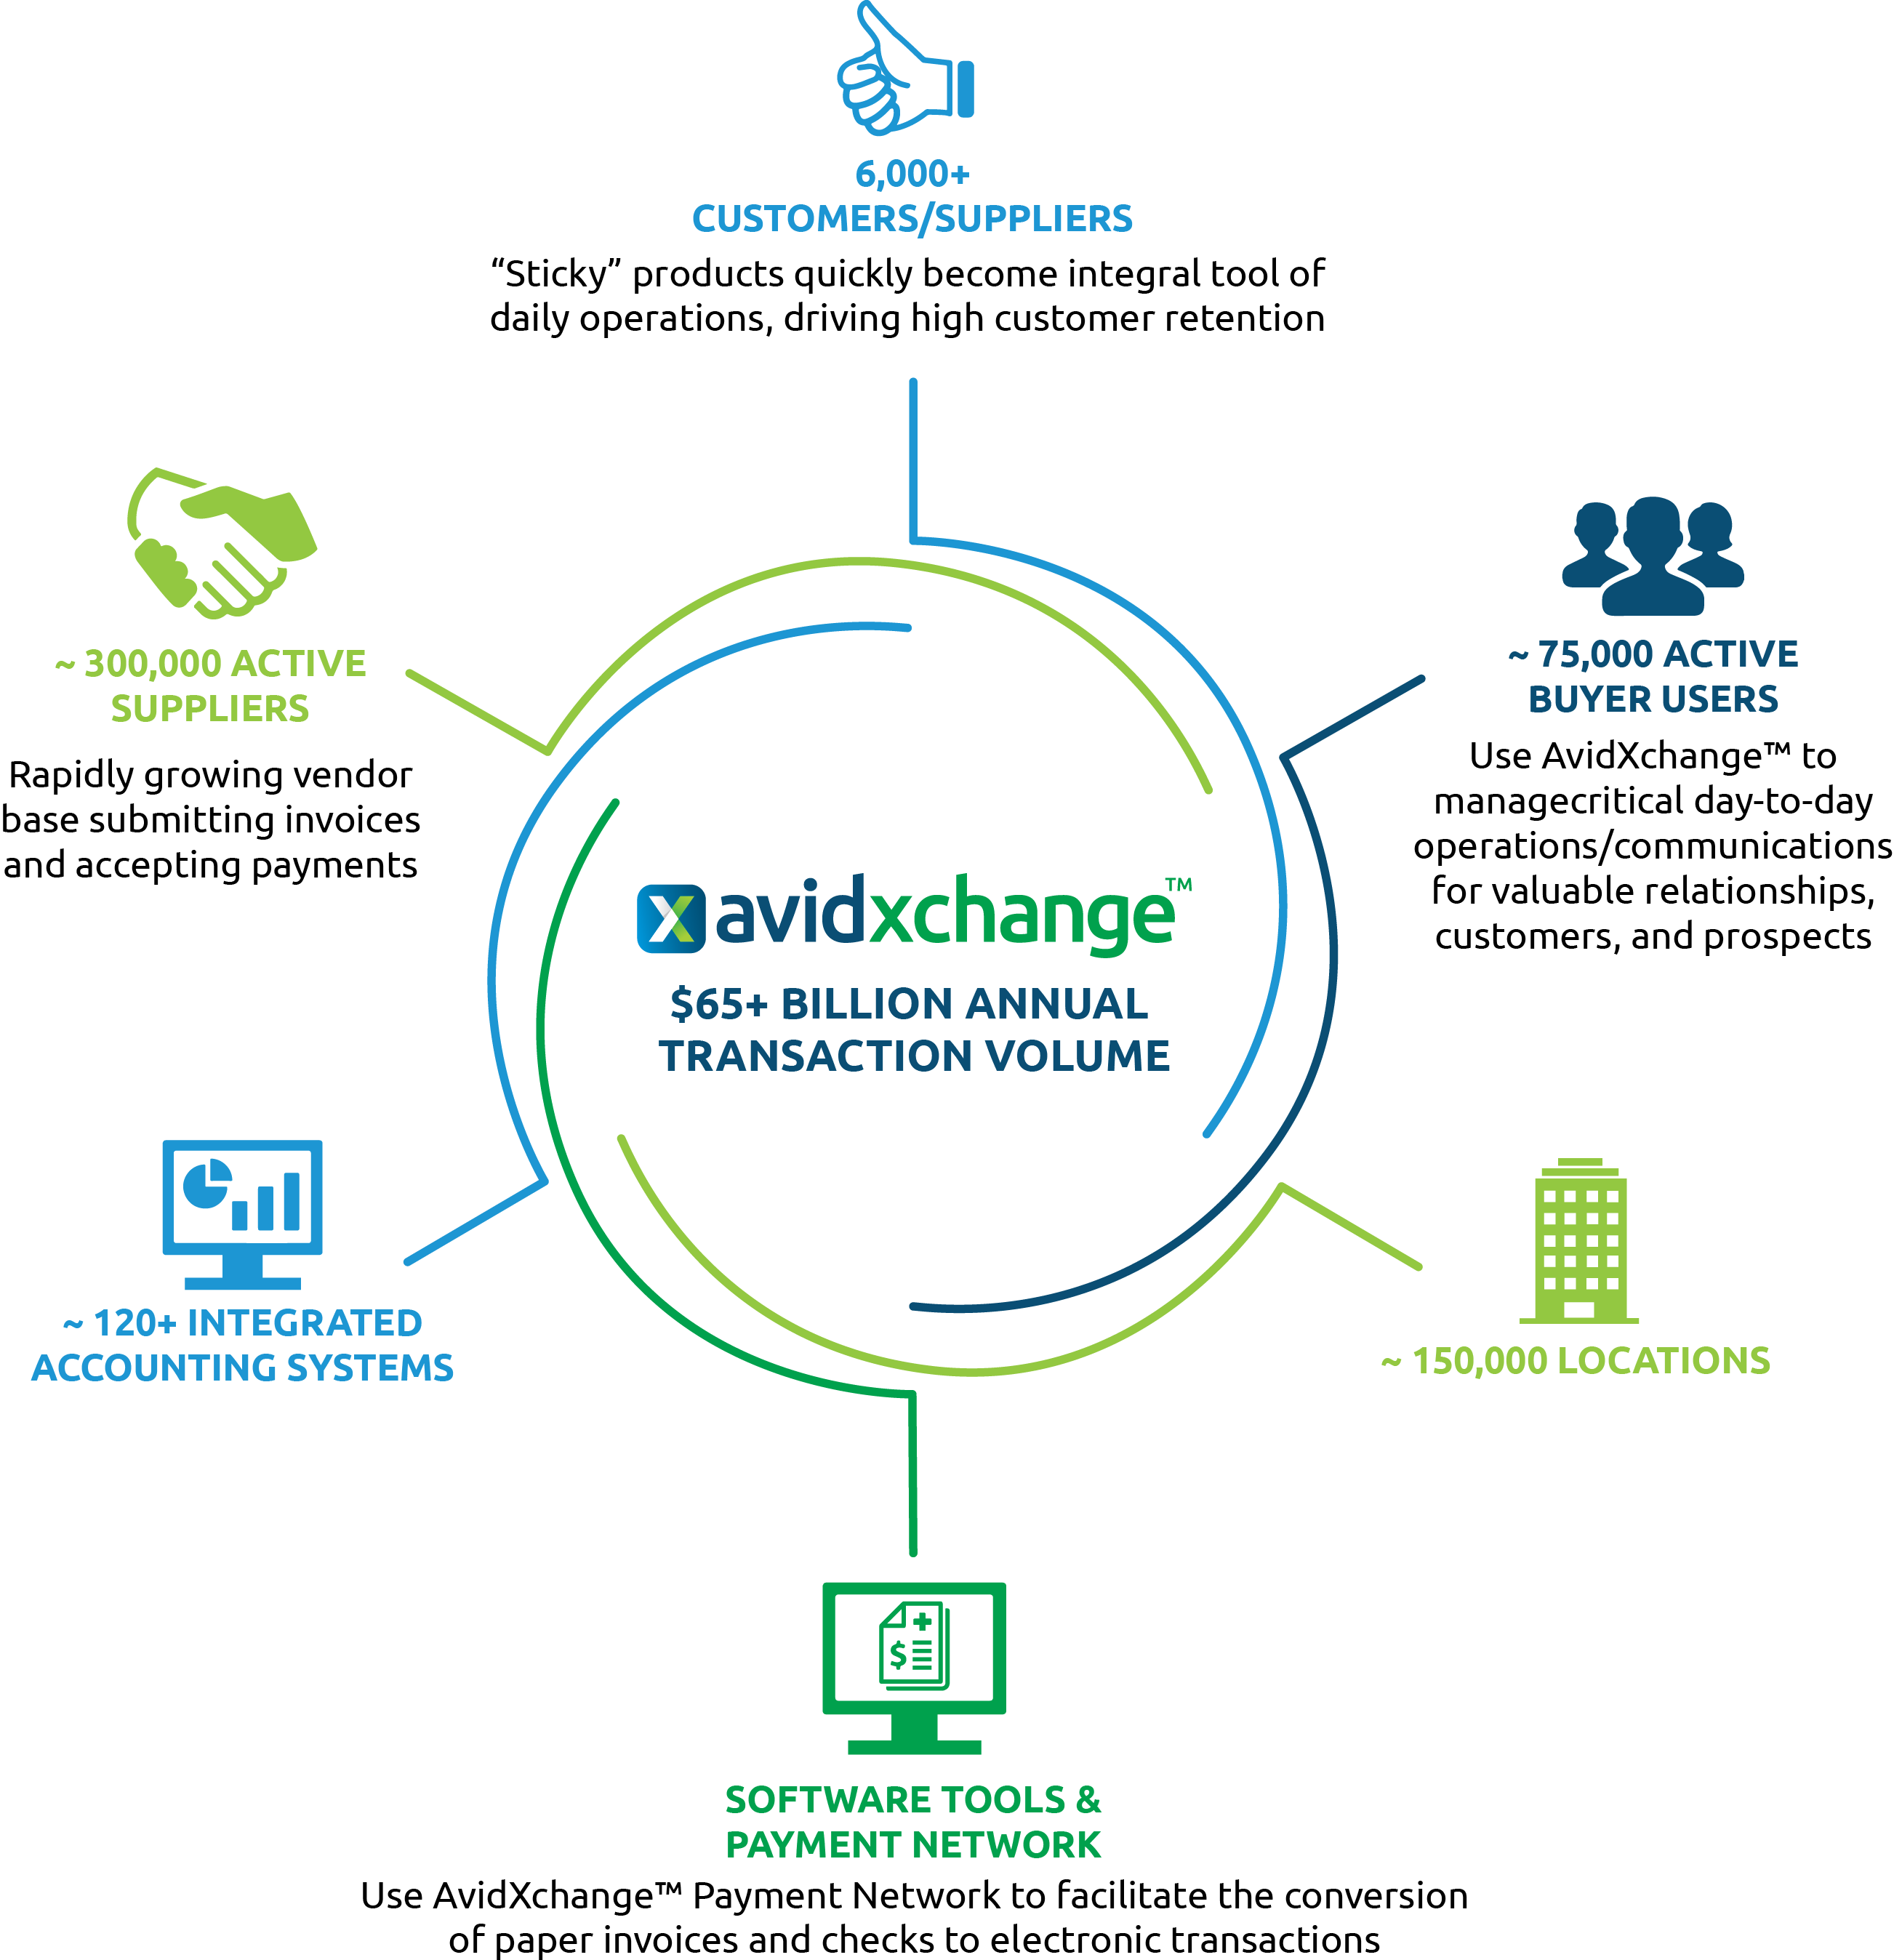

Slide 6
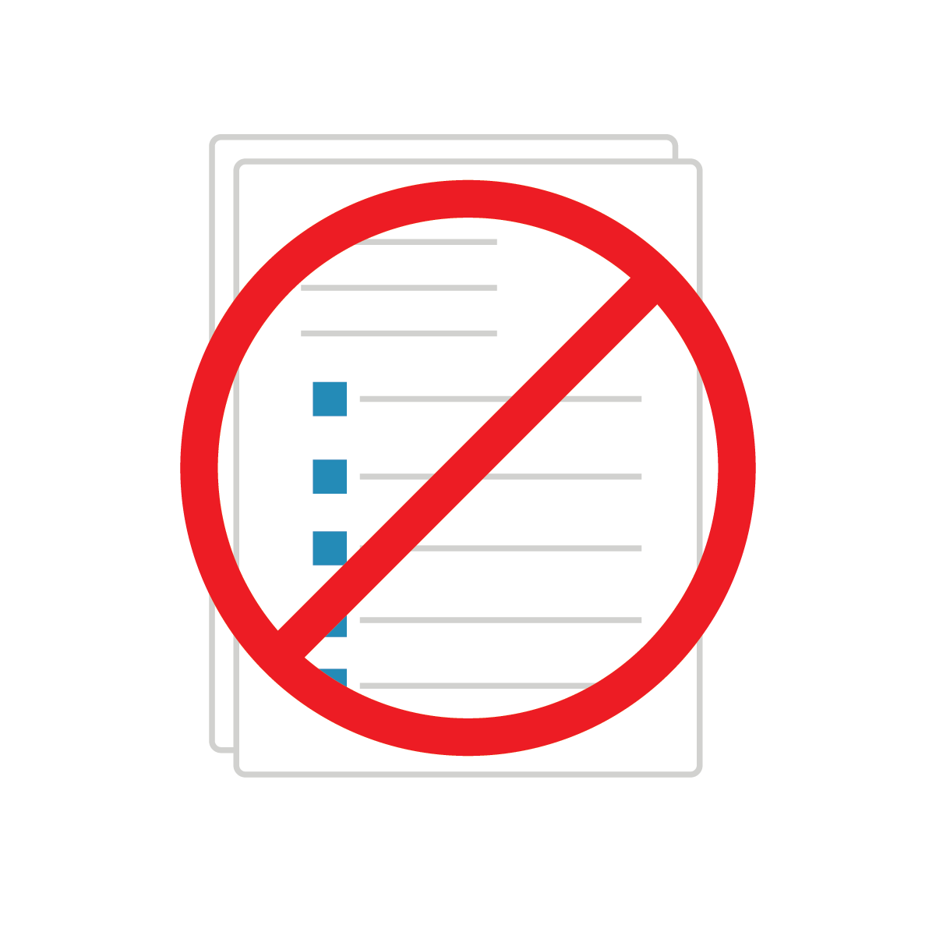
WHAT ARE AP AND PAYMENT AUTOMATION?
Cloud-based solution that integrates with accounting system software to help companies streamline their Accounts Payable workflow, removing manual tasks and paper in the process.
Eliminates tedious tasks like opening the mail, manual data entry, and filing stacks of paper.
Eliminates paper invoices and checks altogether and creates new time for high-level strategic tasks.

Slide 7

WHAT ARE AP AND PAYMENT AUTOMATION?
Automation has been shown to reduce operating costs and processing time.
Added time can be utilized to negotiate vendor discounts and rebate procurement instead of copying and scanning files or searching for misplaced invoices.

Slide 8
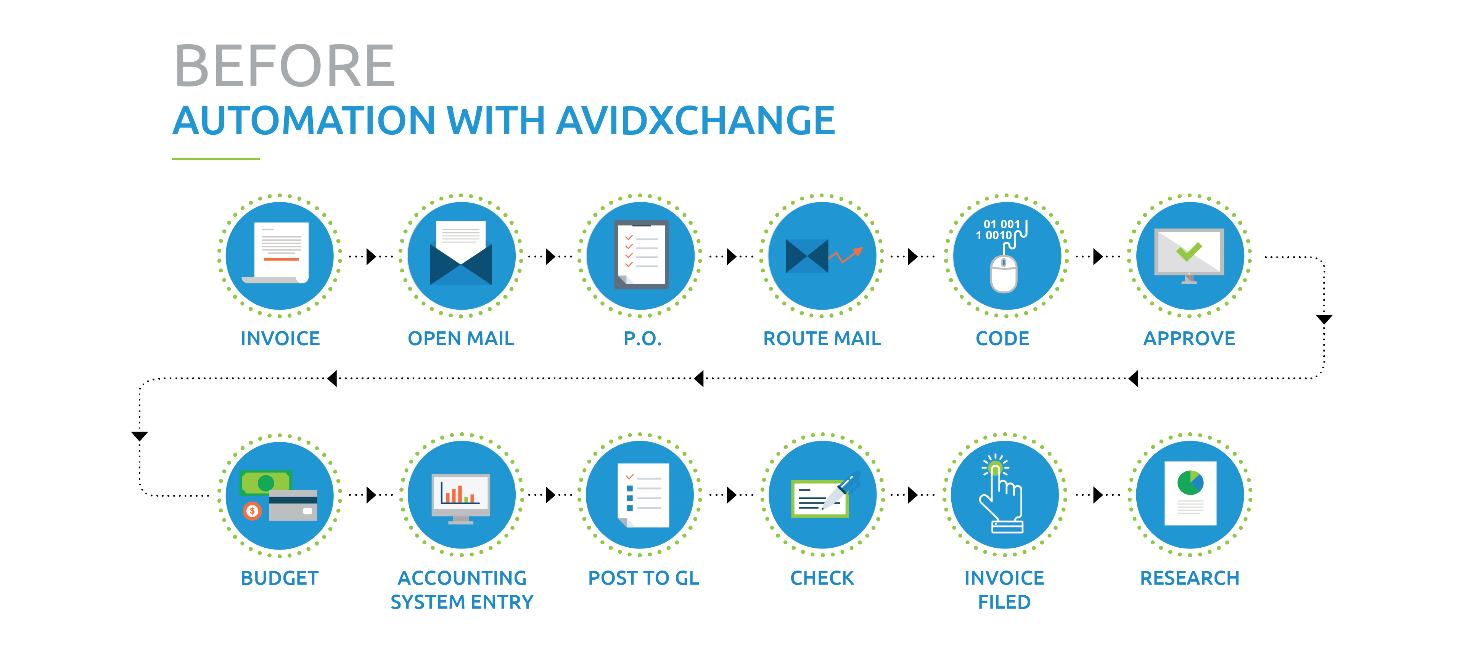

Slide 9
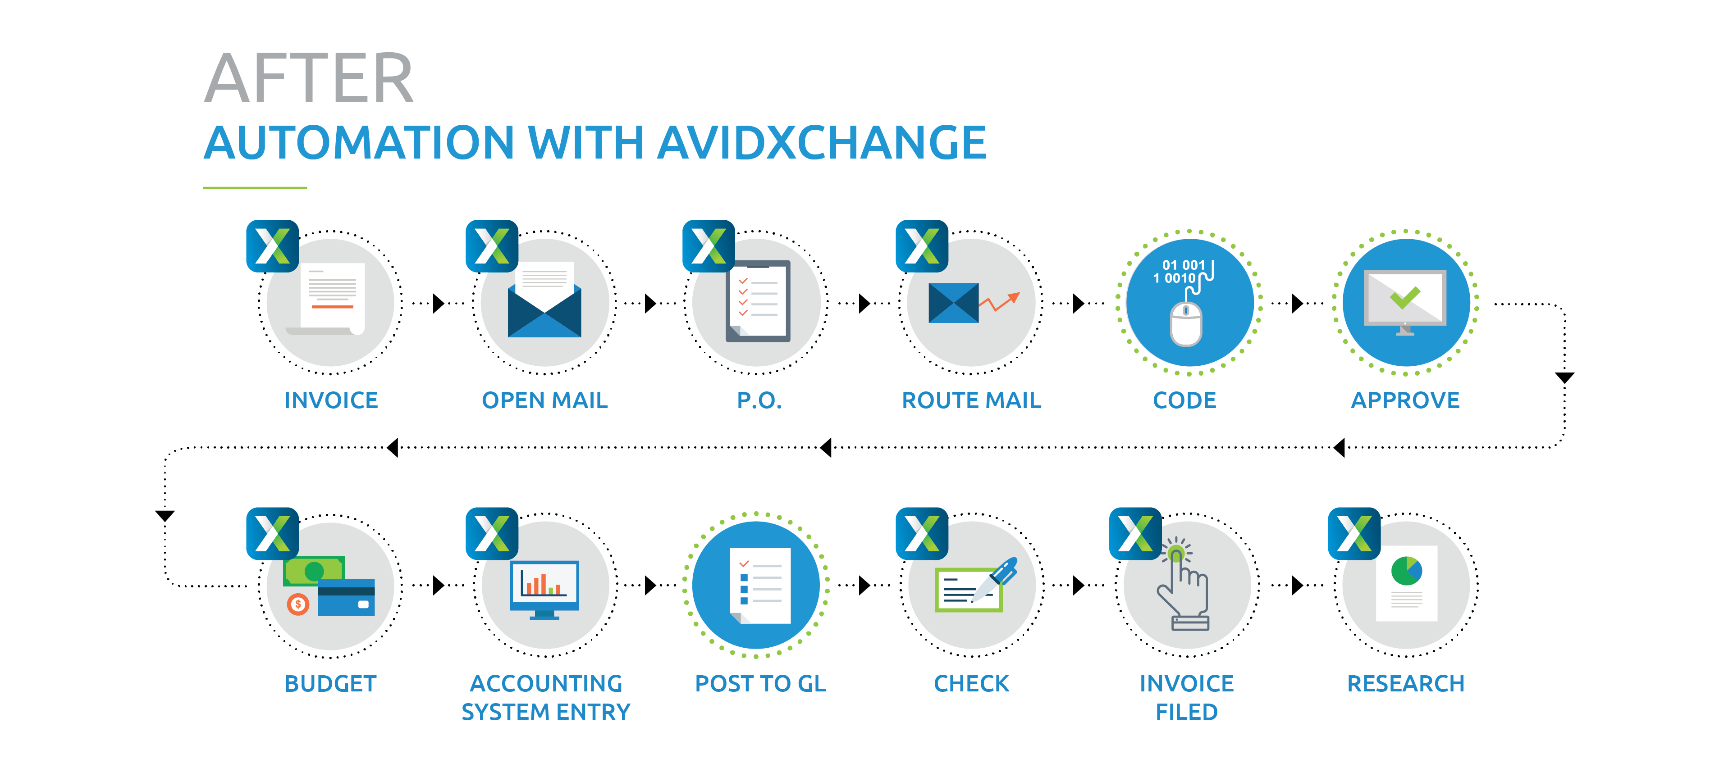

Slide 10
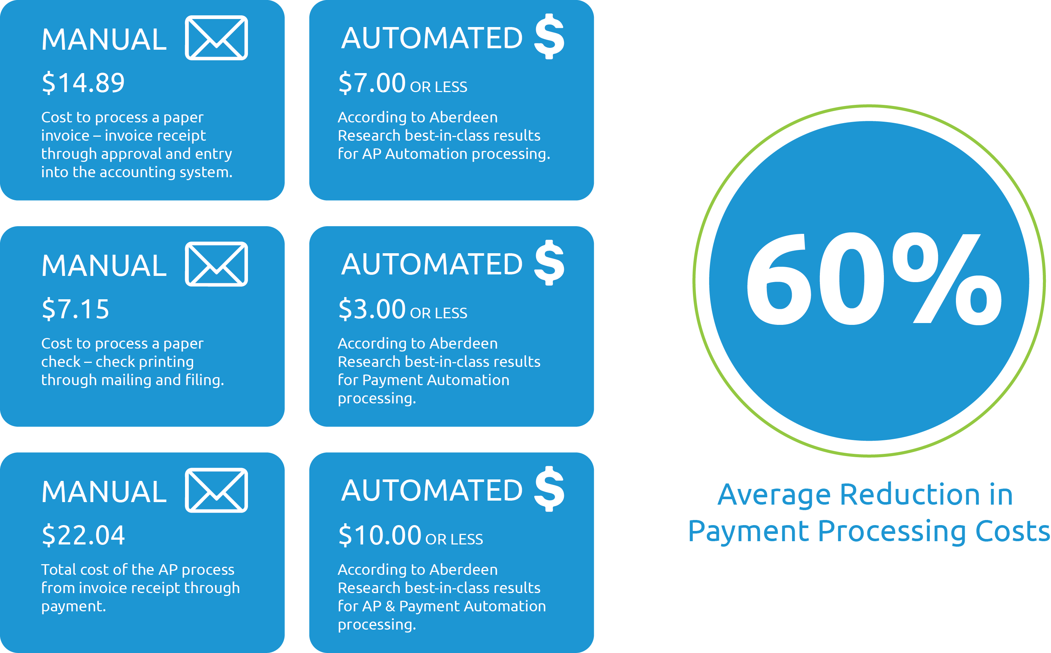
IMPACT OF AUTOMATING PAYABLES

Slide 11
IMPACT OF AUTOMATING PAYABLES

Slide 12
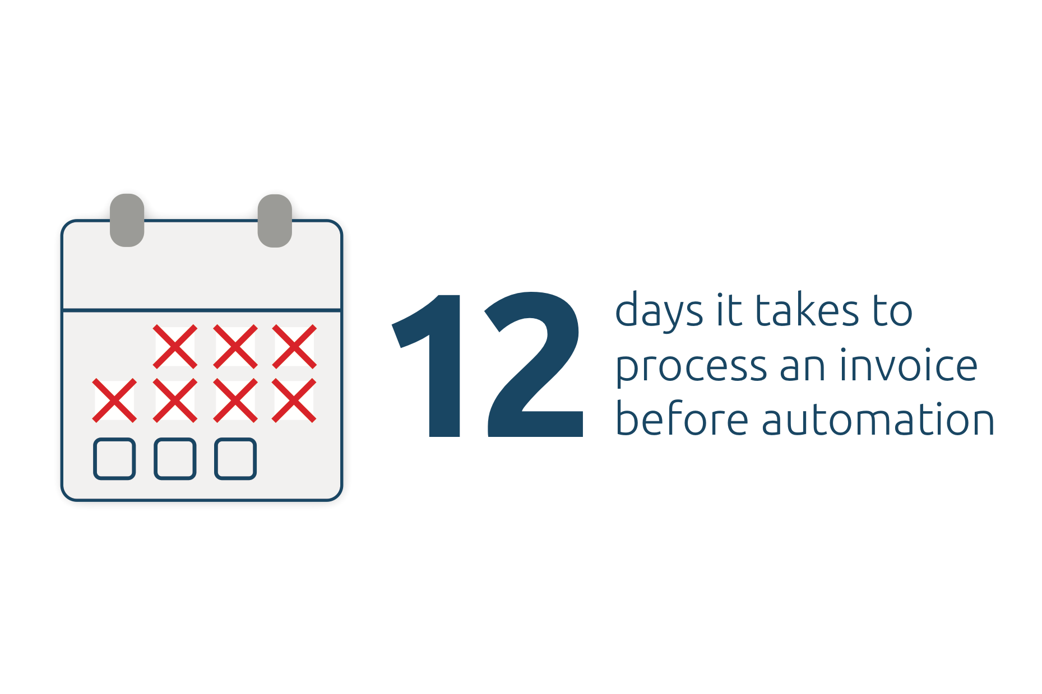
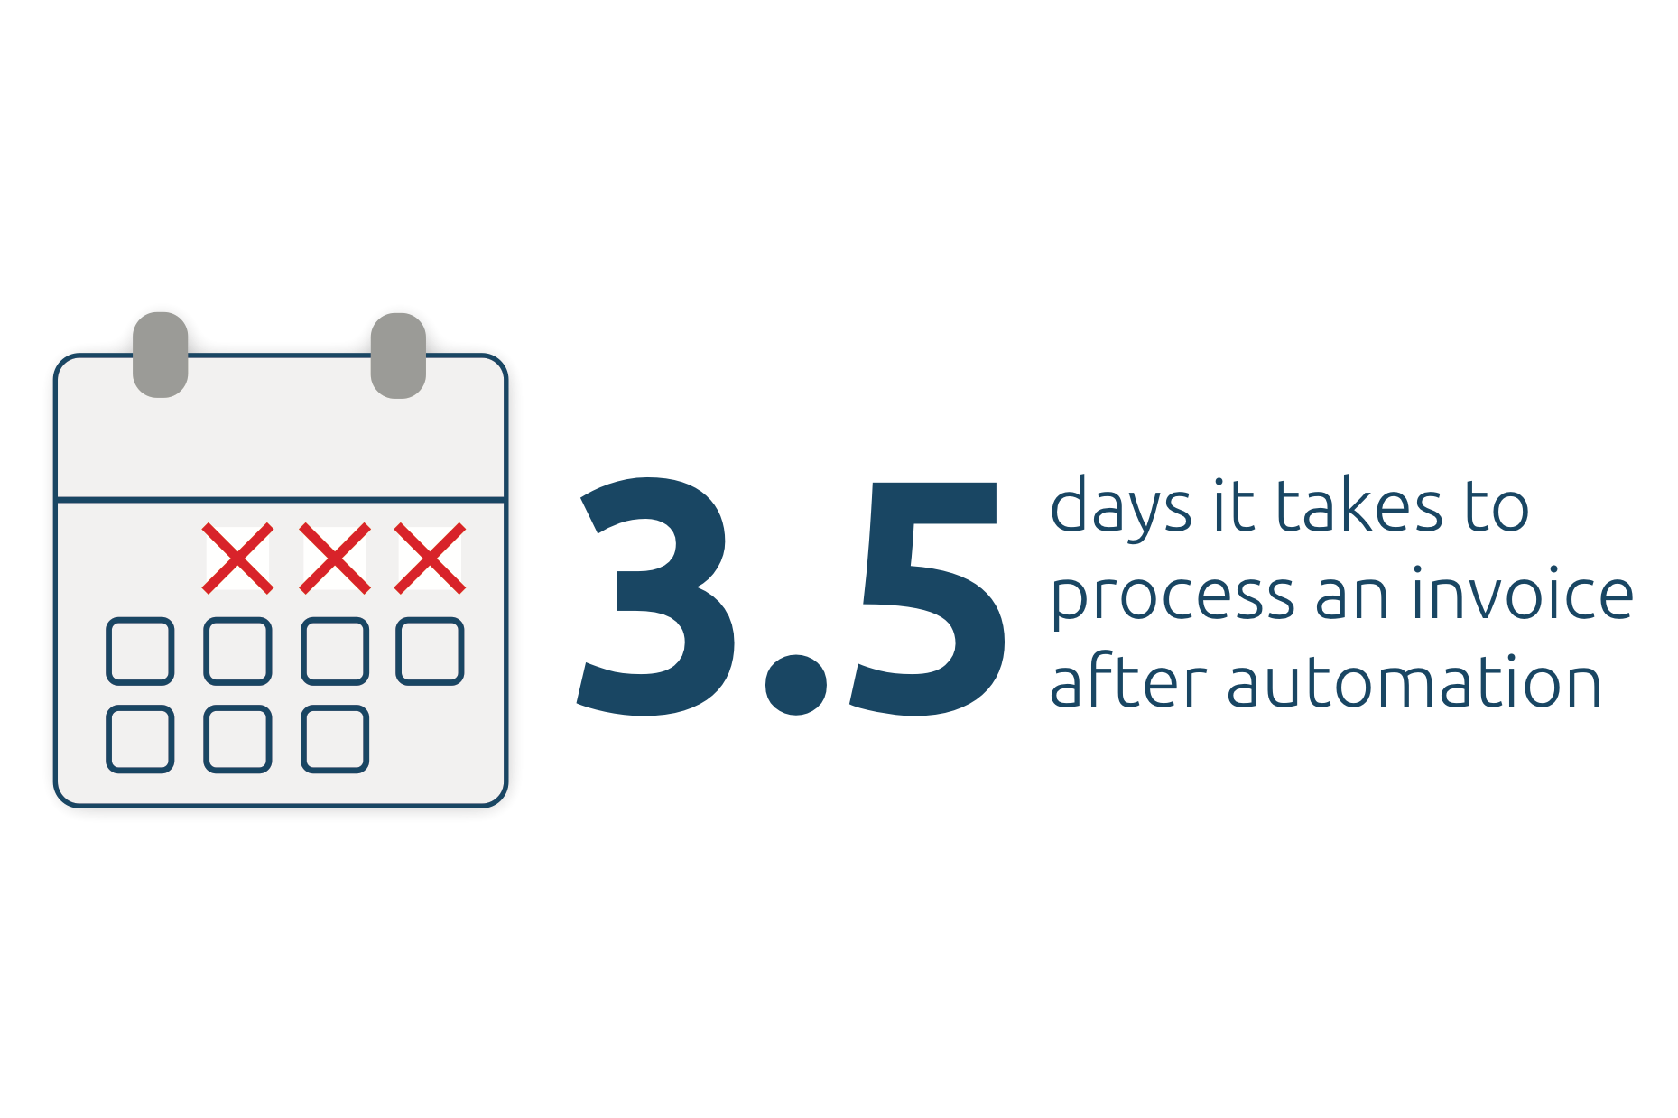
IMPACT OF AUTOMATING PAYABLES

Slide 13

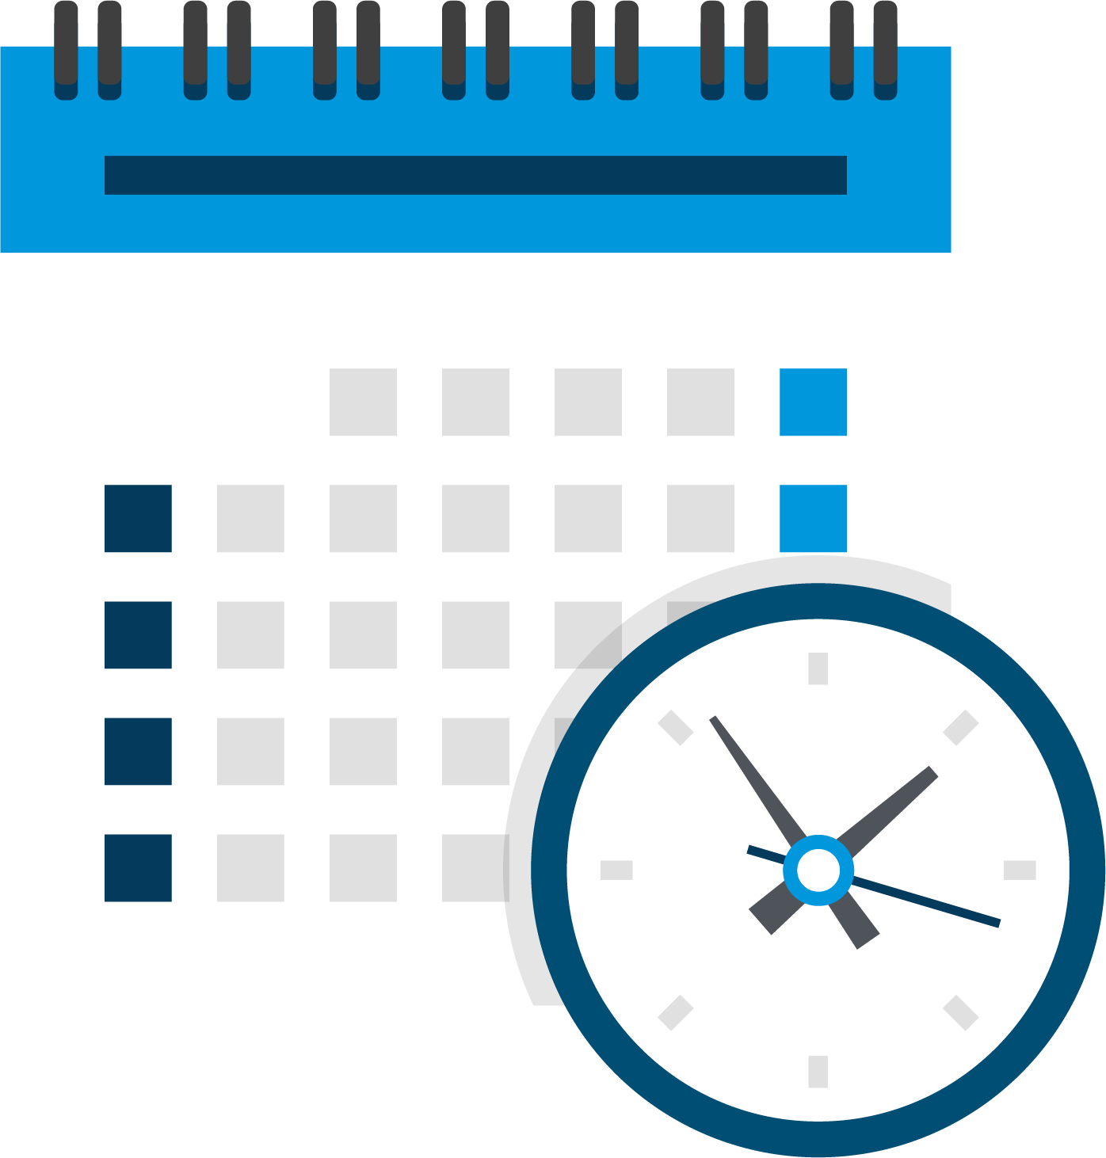
ROI CALCULATOR RESULTS
Edit Numbers based on ROI Calculator Results
$0.00
Your Total Savings Per Month
0
Your Man Hours Saved Per Month

Slide 14
ROI CALCULATOR RESULTS
Edit Numbers below –> Chart Design -> Edit Excel Data

Slide 15
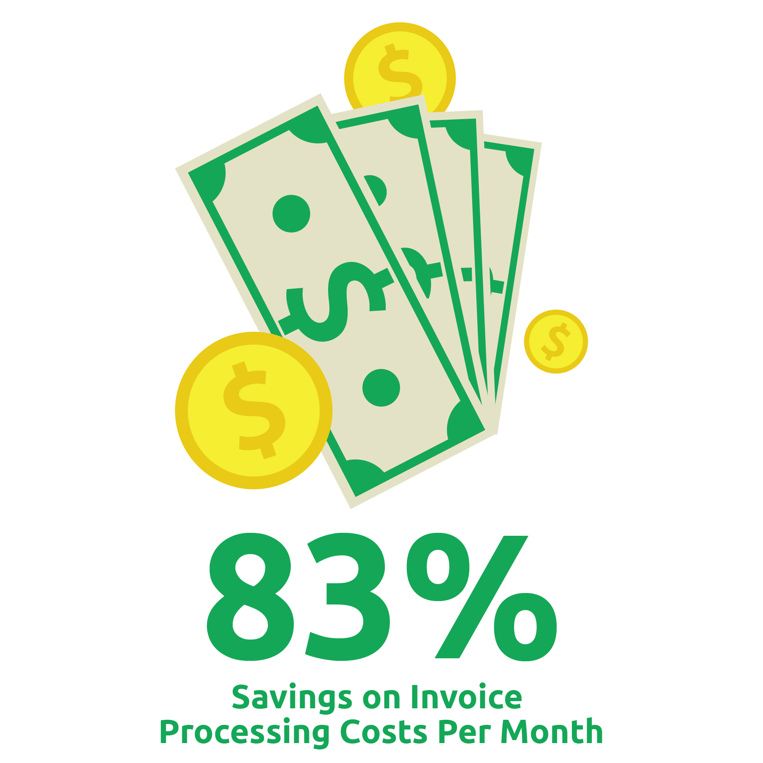
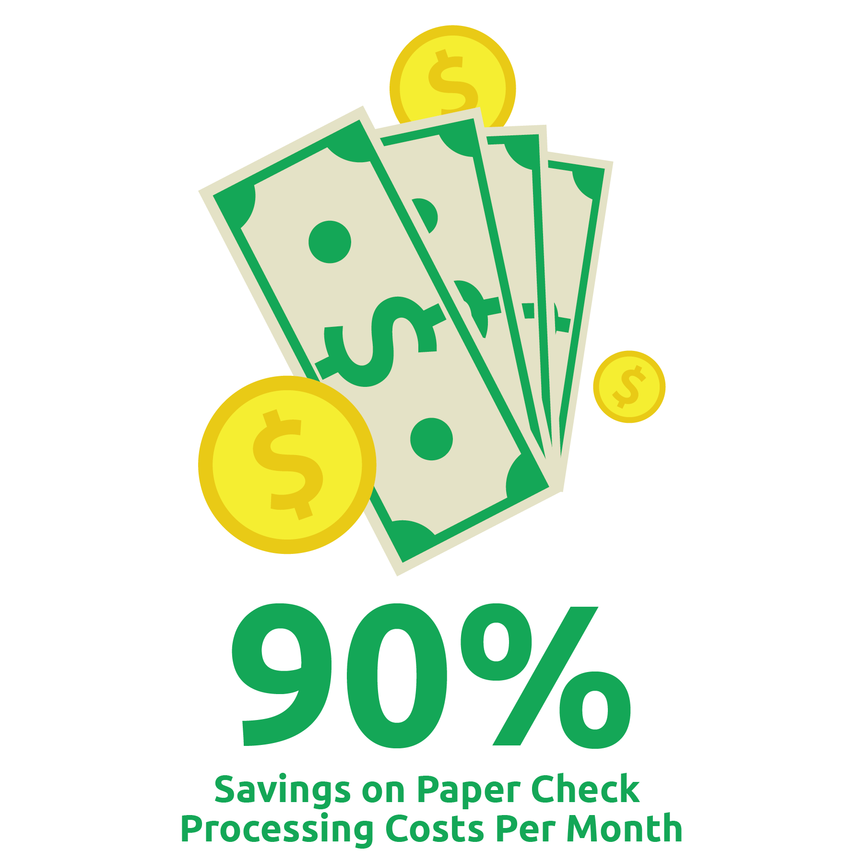
ROI CALCULATOR RESULTS

Slide 16
45-DAY IMPLEMENTATION
Why should we automate, and why now?
It will immediately save time and money, and also enable our AP department to pursue higher-level tasks that will save the company even more money.
Why should we do it now?
Because we are losing money with each day spent committed to the manual, paper-based process.
AvidXchange has a 45-day implementation guarantee, so we could automate and start seeing savings very soon.

Slide 17
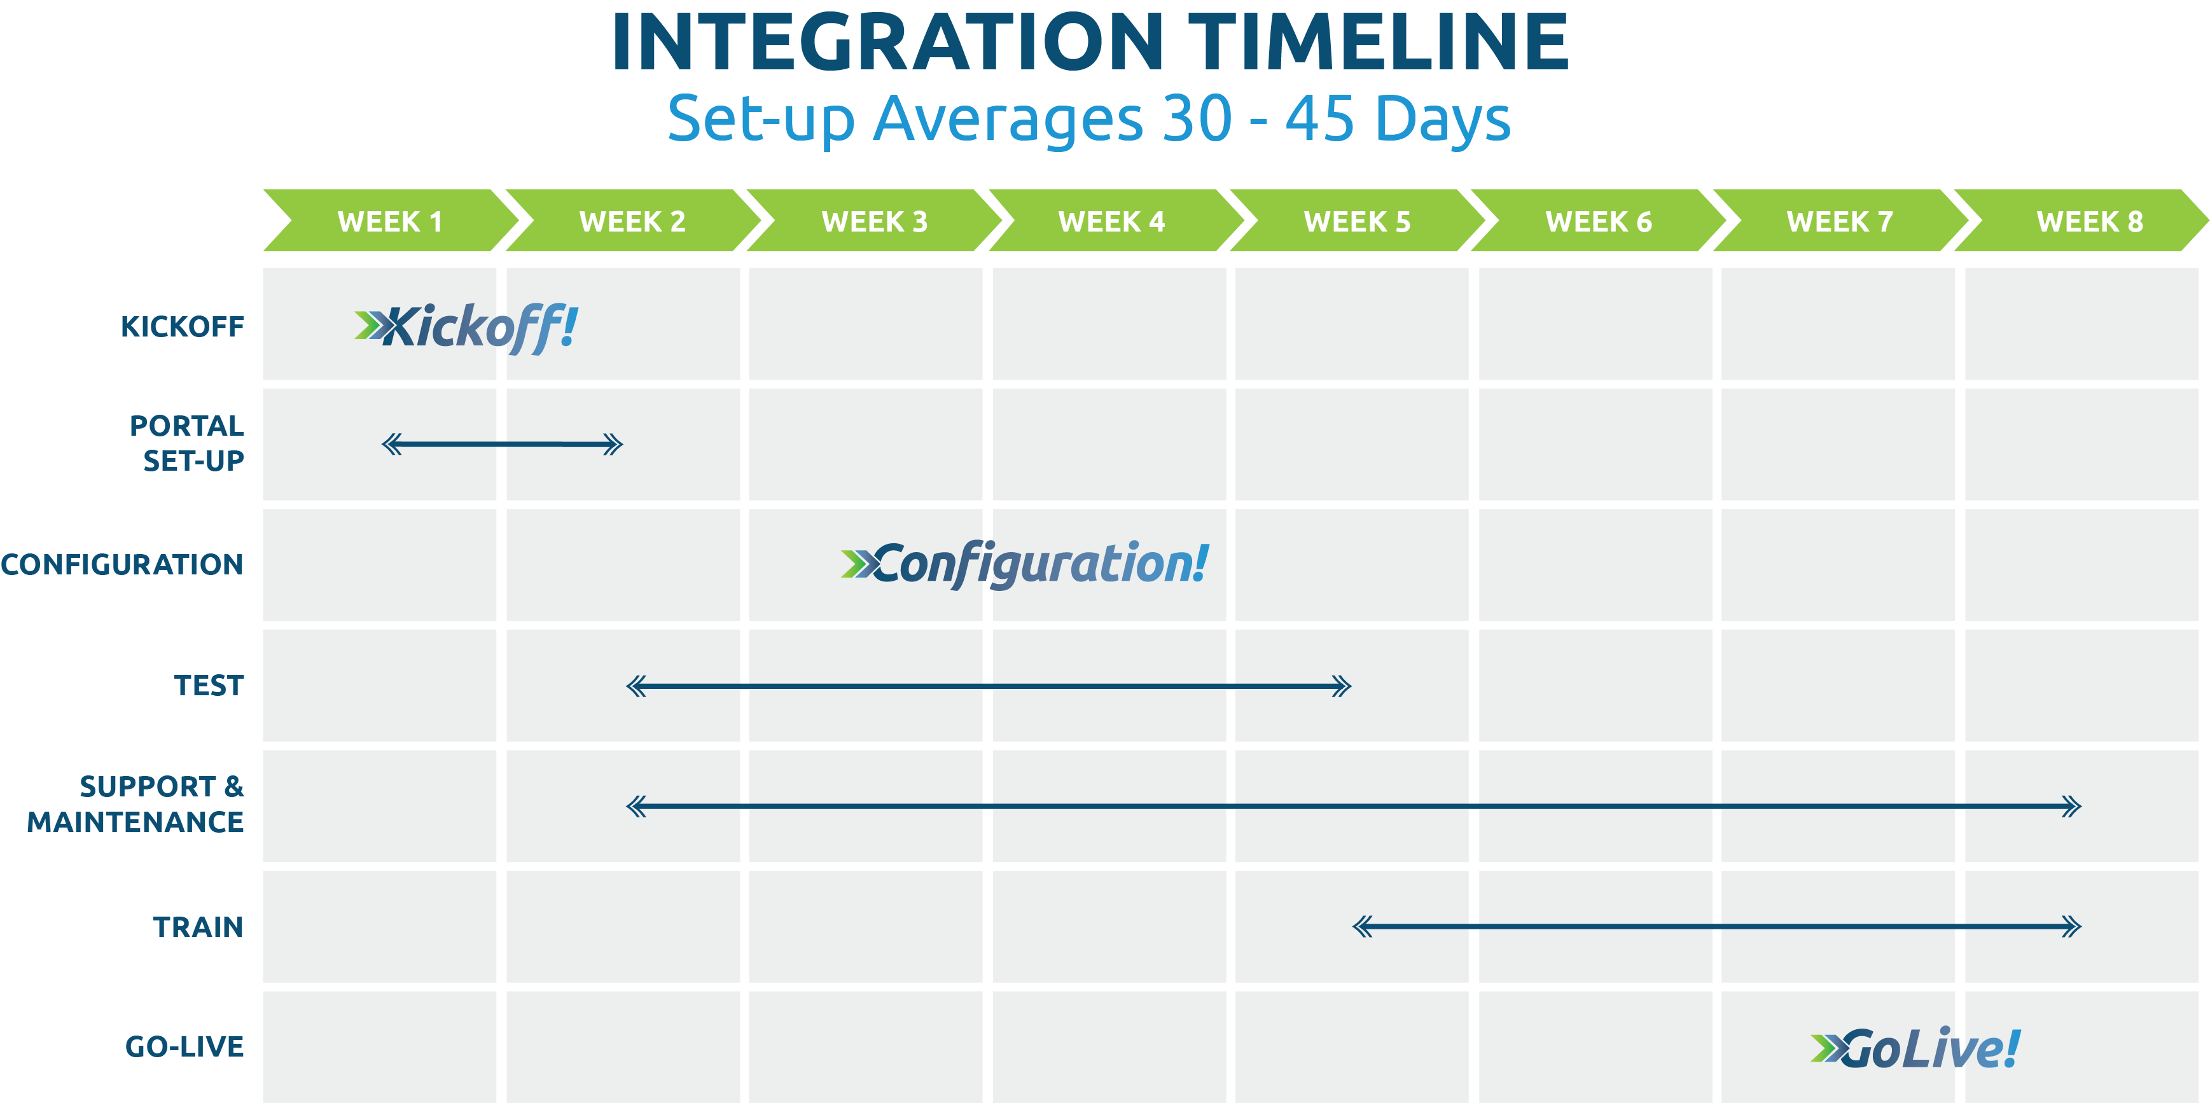

Slide 18


QUESTIONS?

Slide 19
How to Sell AP Automation to Your Organization
+
Insert Your Company Logo Here

